Slide 1
Chalkboard
By Team Bug Generator: Yeongho Lee, Kareem Virani, Giorgio Wirawan, and Chengshui Zhu
CSC336 Project Presentation
7/29/24

Slide 2
Agenda
Intro, Diagram, & Land Demo
Report & Stored Procedures Demo
1
2
3
4
Use Cases & User Action Demo
Extra Credit & Questions
Yeongho Lee
Chengshui Zhu
Kareem Virani
Giorgio Wirawan
Everyone is a teacher and a student.

Slide 3



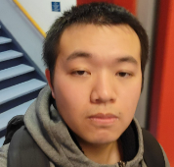
Our Team
Yeongho Lee
Kareem Virani
Giorgio Wirawan
Chengshui Zhu

Slide 4



Tech Stack
Frontend Tech
Our website is a course-based learning and instruction platform allowing users to create, manage, and enroll in courses.
Backend Tech
Database

Slide 5
Profit Model
Chalkboard allows instructors to create and sell courses, with a 10% platform fee deducted from enrollment fees. Here’s how it works:
Course Fee: $100
Platform Fee (10%): $10
Instructor Earnings: $90
Instructors: Keep 90% of earnings
Platform: 10% fee for maintenance and growth
Students: Access high-quality courses
Join us to create, teach, and profit from your expertise!

Slide 6
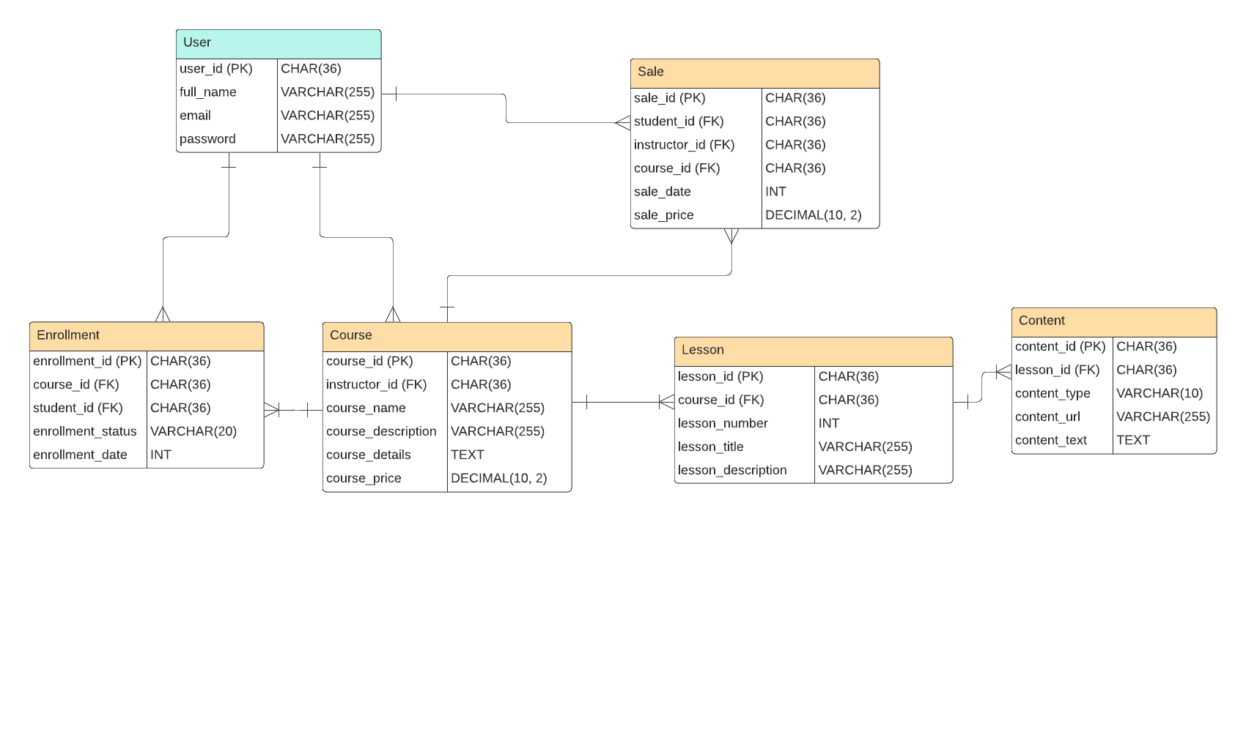
2NF Relational Model Diagram

Slide 7
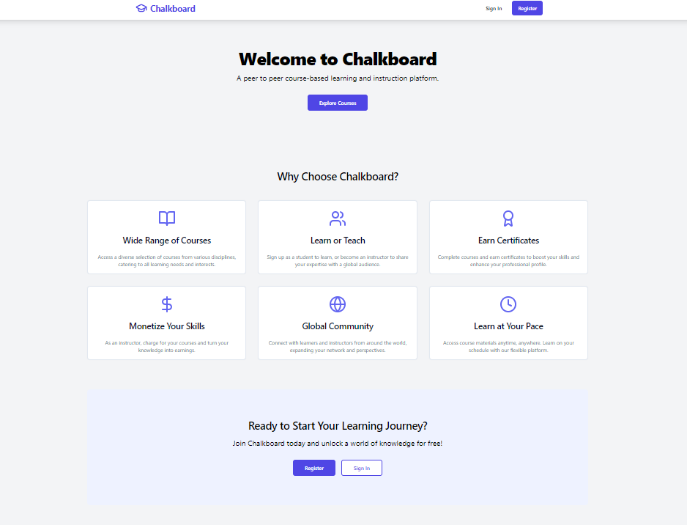
Landing Page Demo

Slide 8
User Journey #1
Login & Signup
Enroll in course
1st
2nd
3rd
4th
Browse & Search course
Learn!!!
User can login and signup with email and password
Courses can be free or charged
User can search up courses with keywords
Access lessons and contents of course and learn!!!

Slide 9
User Journey #2
Login or Sign Up
1st
Create a course
2nd
Manage created courses
3rd
User can login and signup with email and password
(same as student) then navigate to instructor center.
Create a course by entering the course name, price, description, and details.
Create and manage the lessons and their contents of the courses created.

Slide 10
User Action Demo!!!

Slide 11
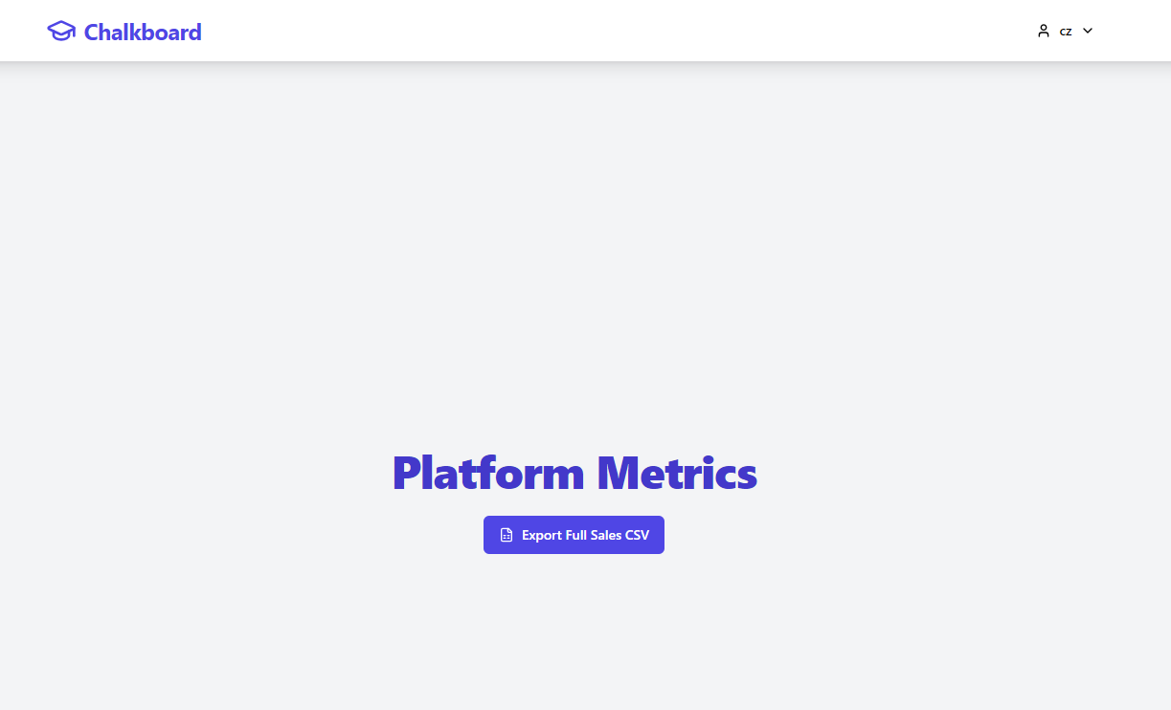
Reporting Demo
Excel

Slide 12
Stored Procedures
AddSampleData
CreateTables
LoginUser
RegisterUser
Populate the database with sample data
Create the tables needed in the database if they don’t exist
Checks for whether the user exist and if password is correct
Check for if user exist and if not add the user data to the database

Slide 13
Job Delegation & Teamwork
Kareem Virani
Chengshui Zhu
Yeongho Lee
Giorgio Wirawan
MVP of the Team
- Constructed backend server with DB integration, API routes to send data to frontend.
- Built core frontend layout, dashboards, landing page, and data visualization components for revenue metrics.
Creation of the frontend of lesson component, course component, and other frontend related pages & components.
- Created the frontend part of the course component content page.
- Assisted with the overall frontend aspects of the page.
Debugging, beta-testing and improvisation.
Frontend Dev & Beta-Tester
Full-stack Dev &
Code Reviewer
Frontend Dev & Product Manager
Frontend developer

Slide 14
Extra Credit Work
Web based GUI
Two diagrams

Slide 15
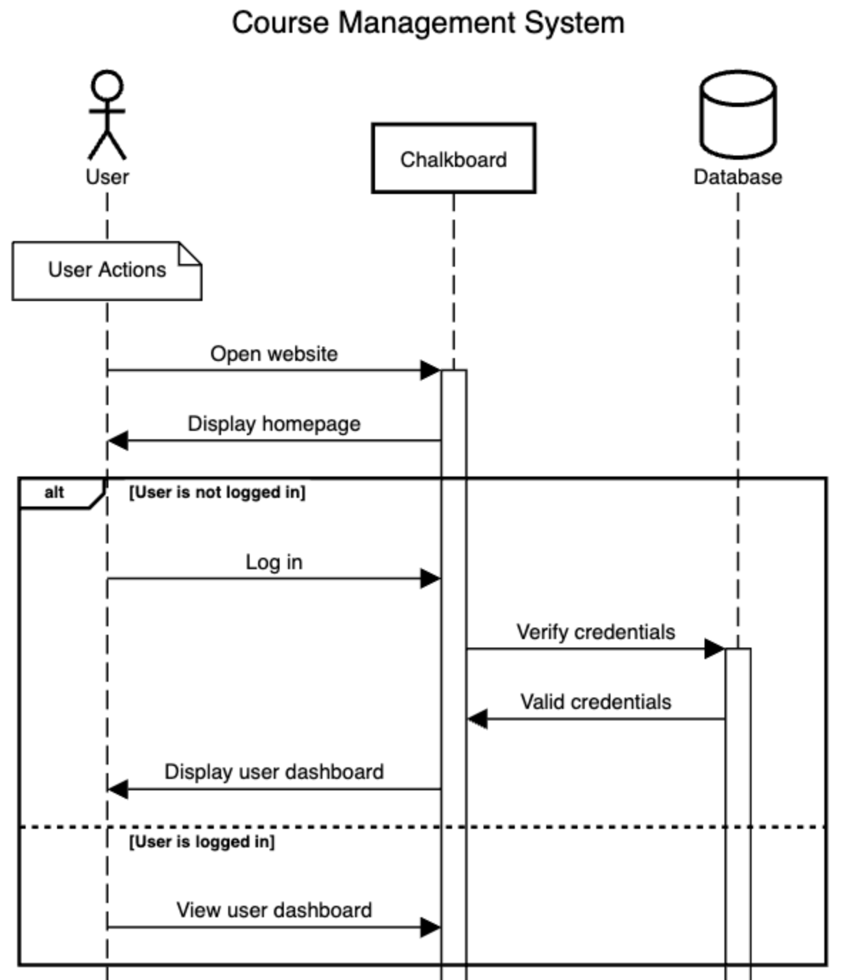
Sequence Diagram

Slide 16
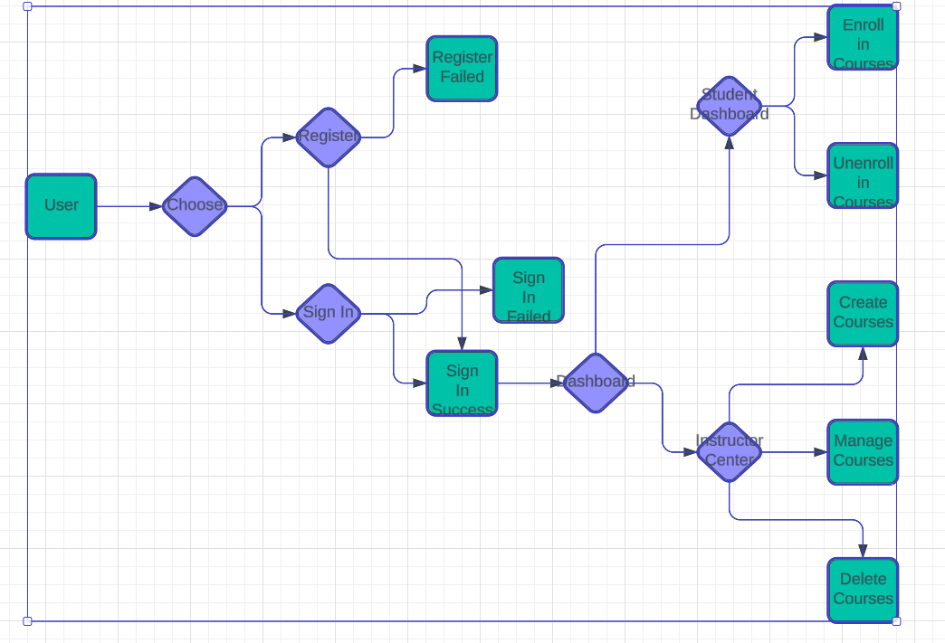
Flow Diagram

Slide 17
Questions?

Slide 18
Thank you!!!
Presented By Team Bug Generator: Yeongho Lee, Kareem Virani, Giorgio Wirawan, and Chengshui Zhu

